Slide 1
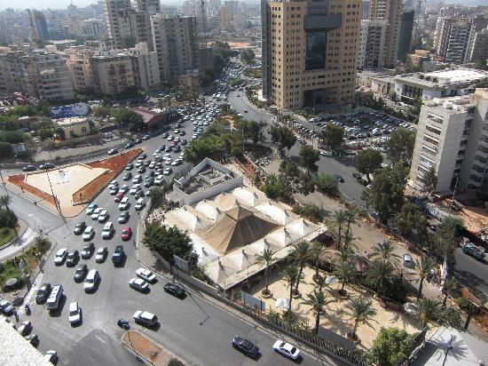

Traffic Impact Assessment – ABC Verdun
John Khoury, PhD, PE
Traffic Management Center
Principal Traffic Engineer

Slide 2
OUTLINE
Project Description
Traffic Counts
Traffic Analysis Scenarios
Intersection LOS Conditions
  Without Project
  With Project
Network Microsimulation Results
Queueing Analysis
Traffic Recommendations

Slide 3
Project Description
A mega scale mall is planned to open this summer in Verdun area, between Verdun Street, Al Rachideen Street and Tamer Mallat Street.
The mall is the largest mall in the area and will be the main attractor for shopping.
Traffic into the mall and out will peak in the afternoon hours, which is assumed for the traffic analysis.
Around 1000 vehicles are assumed to enter and 900 vehicles to exit during one peak hour.

Slide 4
Traffic Counts
Tuesday, July 11, 2017
Wednesday, July 12, 2017
Counts were taken during good weather
Counts were taken for three hours, morning, midday and evening peaks over two weekdays
Counts were conducted at the intersections, including all movements

Slide 5
Traffic Analysis Scenarios
Existing Conditions – ABC still closed (without ABC traffic)
Existing Conditions – ABC open (with ABC traffic)
Modified timing / suggested improvements (with ABC traffic)

Slide 6
Intersection LOS Assessment
Intersection LOS Comparison for PM Peak Hour
Street | Int. | w/o ABC |  | with ABC |  | With ABC modified timing
 |  | delay/veh | LOS | delay/veh | LOS | delay/veh | LOS
Rachideen | 505 | 31.2 | C | 95.7 | F | 40.2 | D
 | 53a | 7.4 | A | 16.1 | B | 11.6 | B
 | 53 | 7.4 | A | 23.3 | C | 8.9 | A
 | 53b | 8.7 | A | 10.6 | B | 8.8 | A
 | 55 | 30.6 | C | 36.9 | D | 46.8 | D
Verdun | 57 | 47.3 | D | 90.3 | F | 48.4 | D
 | 39 | 18.4 | B | 90.2 | F | 37.8 | D
 | 39a | 16.6 | B | 31.1 | C | 26.1 | C
 | 504 | 46.4 | D | 51.3 | D | 55.9 | D

Slide 7
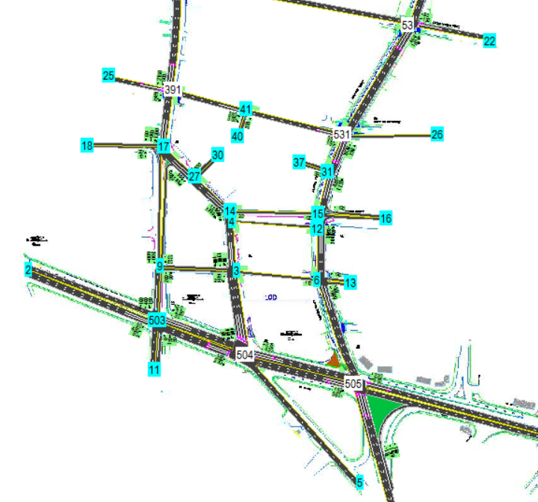
Network Analysis - simulation
System Wide Microsimulation Results
Scenario | Total Delay | Average Delay/veh | Average Speed | Served
 | (hr) | (sec) | (kph) | (veh)
Current/Existing | 222 | 89 | 19 | 8600
With ABC Traffic | 446 | 154 | 13 | 9550
Percent Change | 101% | 73% | -32% | 11%
With signal re-timing | 295 | 99 | 18 | 10250
Percent Change | -34% | -36% | 38% | 7%

Slide 8
Queueing Analysis
Service Channels |  | 1 |  | 2 |  |  |  | 3
Arrival Flow | veh/hr | 200 | 300 | 200 | 300 | 400 | 500 | 200 | 300 | 400 | 500
 | veh/min | 3.33 | 5.00 | 3.33 | 5.00 | 6.67 | 8.33 | 3.33 | 5.00 | 6.67 | 8.33
Service rate | veh/min | 4.00 | 4.00 | 8.00 | 8.00 | 8.00 | 8.00 | 12.00 | 12.00 | 12.00 | 12.00
System Utilization |  | 0.83 | 1.25 | 0.42 | 0.63 | 0.83 | 1.04 | 0.28 | 0.42 | 0.56 | 0.69
Queue | (veh) | 4.17 | ∞ | 0.30 | 1.04 | 4.17 | ∞ | 0.11 | 0.30 | 0.69 | 1.58
Service Time | (min) | 1.50 | ∞ | 0.21 | 0.33 | 0.75 | ∞ | 0.12 | 0.14 | 0.19 | 0.27
Arrival rates are random and variable
Service rates around 4 vehicles per minute, per ticket channel
Two ticketing channels per entrance to minimize queues and service time
Preferred 25 meters of storage if two ticketing channels are used

Slide 9
Traffic Recommendations
Provide two ticketing channels at every entrance
Provide 25 meters of storage per lane entrance
Re-optimizing of cycle timing/phasing at all intersections in vicinity
Reconfigure intersection 39 to allow dual left turn
Regulate with enforcement street parking along Verdun street
Restrict access from NB Verdun free right-turn into ABC
Mall exit along Tamer Mallat, only right turn
Amine Takeyyeddine street, only right turn to Verdun street (no through movement)

Slide 10
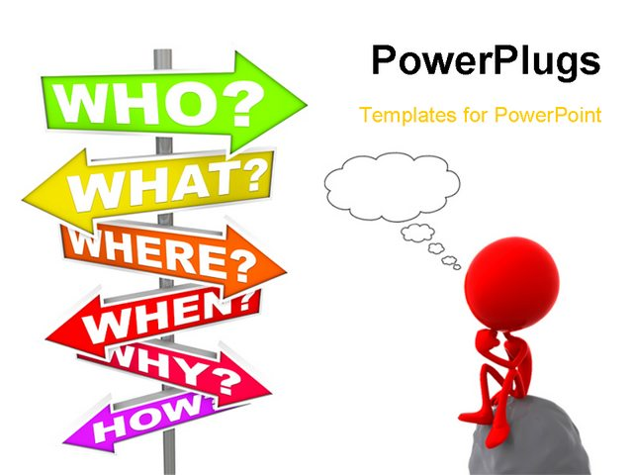
Questions
Q & A
???

