Slide 1
Restructuring and rightsizing:
EU experiences and options for Lebanon
Wrap-up session
Restructuring in EU and OECD countries
Xavier Sisternas, SIGMA
Beirut, 25-26 September 2019

Slide 2
Restructuring buzzwords
Workforce planning
Rationalisation
Downsizing
Rightsizing
Streamlining
Cutback management
Merging
Freezing recruitment
Layoffs
Reallocation
Pay restraints
Redundancies
Consolidation strategies
Early retirements
Public bodies reforms

Slide 3
Why?

Slide 4
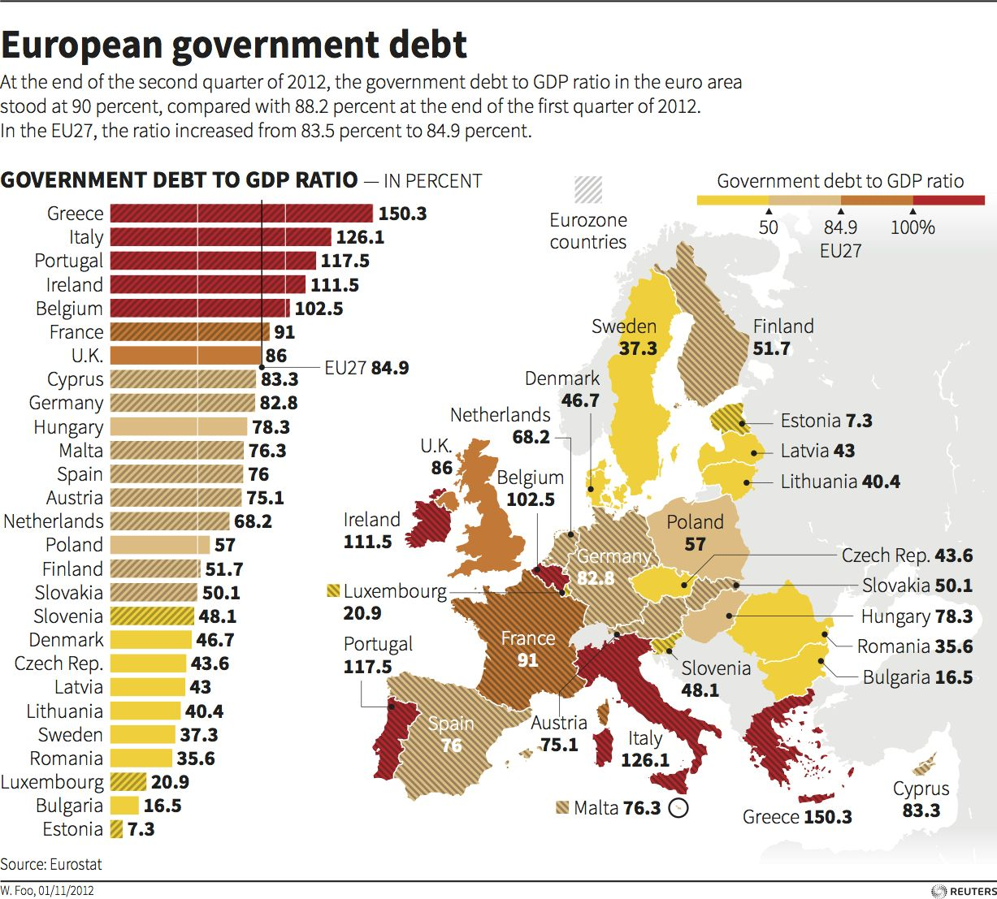

Slide 5
Crisis-hit countries
pushed through badly needed reforms,
improving public finances
and increasing competitiveness

Slide 6
Typology of usual cost-cutting measures
(EU/OECD, 1997-2019)
[Reducing public functions and services]
[Reducing investments]
[Reducing social benefits]
Human resources (HR)
Organisation of the public sector
Internal reorganisations
Territorial structures

Slide 7
1) Human resources (HR)
Across the board or Selective
Recruitment freezing (with/without exceptions) + Reduction of staff by attrition
Other hiring limits
Early retirements
Voluntary/incentivated redundancies
Compulsory redundancies (with/without outplacement)
Reduction of temporary staff
Reduction of support and other non-core positions
Reduction of management positions
Career breaks
Pay cuts (salaries)
Reduction of allowances
Reduction of non-monetary benefits
Lower salary scale (for new recruits)
Transfers to part-time positions
Increase of working hours
Reduction of leave days
Reduction of pensions
Redeployments of staff (voluntary or compulsory)
Teleworking

Slide 8
2) Organisation of the public sector (“macro”measures)
Abolishment or merging of ministries
Abolishment or merging of public bodies
Absorption of public bodies by parent ministries
Amalgamation/Centralisation of corporate services (shared service centres) at ministry or Government level
Joint services: voluntary agreements to share services
Amalgamation of premises
Moving administrative buildings to cheaper areas
One-stops-shops and call-centres (amalgamation of public services’ offices)
Closing inefficient SOEs

Slide 9
3) Internal reorganisations (“micro” measures)
Suppression or merging of units
Reengineering of processes (BPR) and streamlining of service chains
Simplification, digitalisation or suppression of administrative procedures
Outsourcing of non-core tasks (to the private sector)
Outsourcing of certain public services (to non-profit or to the private sector)
Insourcing (taking in-house processes that are currently run by third parties)

Slide 10
4) Territorial structures
Closing or merging inefficient offices/branches
Reorganising the territorial networks on the national administration
Transferring services to local/regional governments
Consolidating municipalities
Providing local services at supramunicipal level

Slide 11
Lessons for Lebanon?

Slide 12
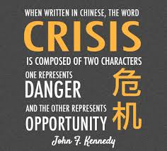
JFK: …in a crisis, be aware of the dangers, but recognize the opportunities
Notes:
Crisis creates opportunities: problems ignite our creativity and can make us think out of the box

Slide 13


Slide 14
Defining the restructuring programme
Assessment/Diagnosis?
Available data?
  Staff? Expenditure?
  Workload/Demand?
  [Do we have a “public sector inventory”?-Toolkit 1]
Scope?
Timeframe?
Measures: Across the board? Selective?
Resources? [some reforms need initial expenses…]
Ensure merit and evidence-based measures; avoid arbitrary decisions

Slide 15
Who is in charge?
Leadership is needed for the kind of high-quality change management capable of building confidence and sustaining capacity for reform.

Slide 16
Change management
External dimensions
(political + social climate)
Political level: government and opposition
Consultations with other ministries and public bodies
Opinion-makers: university, think tanks,…
Social: impact on users, consultation with NGO
Media, social media, public opinion…
Support from donors
Internal dimensions
(work climate)
Leadership, visibility and availability of senior managers
Communication strategies with affected and non-affected staff [“perception management”]
Consultation with trade unions
Training and support for middle managers
Counselling and support for staff
Notes:
Distinction (difficile) entre la sphère politique et la sphère administrative

Slide 17
What else?
Stick to good management practices. Making the most of the resources available and the workforce is one of the main priorities
Pay attention to potential negative impacts: lack of capacity, loss of talent and expertise, low morale…
Workforce adjustment measures should be selected in the framework of a strategic workforce planning aimed at minimizing adverse impacts

Slide 18
Think
Short term and Long term
Short term: reductions? mobility? cost-cutting?
Long-term: sustainable organisations, sustainable workforce, sustainable public services

Slide 19
The key question:
How to restore public finances
while preserving key public services
and promote sound economic growth?

Slide 20
And never forget…
Public authorities should maximize the “public value” delivered to the citizens: a good reformer reduces costs but does not reduce the value created for the citizens

