Slide 1
Restructuring and rightsizing: EU experiences and lessons for Lebanon
Restructuring the public administration
- Portugal experience -
Eugénio Antunes, ESPAP, Portugal
Beirut, 25-27 September 2019

Slide 2
PORTUGAL: SOME CHARACTERIZATION DATA
Population_____________________________________10.283.822
Active Population_________________________________ 5.232.600
GDP (million €) ______________________________________201.606
GDP per capita (nominal prices - 2011) ____________________ 17.873 €
Public expenditure (GDP %) _______________________________44%
Public Employment:
a) Central Administration________________________ 516.454
b) Regional and Local Administration________________156.474
Companies (nr.) _____________________________________1.260.436
Unemployment rate______________________________________7 %
Inflation rate___________________________________________ 1 %
www.pordata.pt

Slide 3
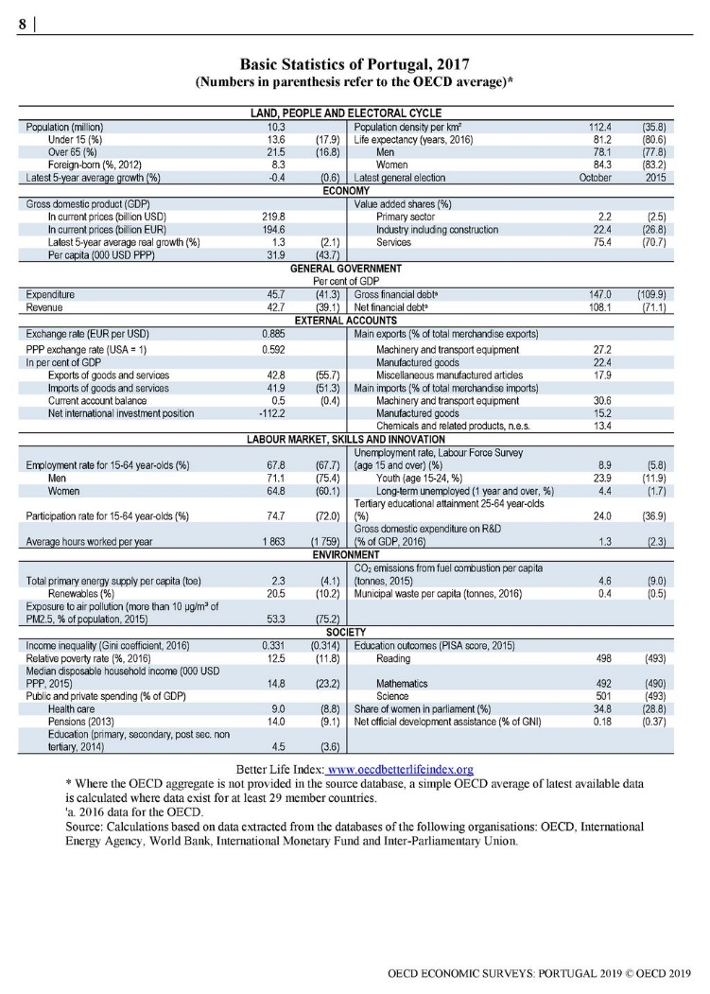
OECD Economic Surveys: Portugal 2019
https://read.oecd-ilibrary.org/economics/oecd-economic-surveys-portugal-2019_eco_surveys-prt-2019-en#page5

Slide 4
OECD Economic Surveys: Portugal 2019 (cont.)

Slide 5
CONTEXT OF PORTUGAL REFORMS
“Administrative reform in Portugal: problems and prospects”
Rocha & Araujo (2007)
Administrative reform has been on the political agenda since 1974.
Portugal was a country with two systems: the old traditional system, which was deeply rooted in a traditional and rural society and the new and modernized institutions.
The government’s main concern was concentrated on three main issues:
a) to dismantle those services ideologically connected to the old regime;
b) to destroy the power of strong economic groups (monopoly positions);
c) to build the social state.
The model established by the Constitution after the democratic revolution required a large administrative structure.
The democratic revolution represented an increase in the number of public enterprises, and in its aftermath the government started a vast process of nationalization (vg. insurance, banking, power production, transport, chemistry, shipbuilding, etc) and increased the role of the state.

Slide 6
CONTEXT OF PORTUGAL REFORMS (cont.)
Concerning the civil service, important changes took place: the career system, retirement, and disciplinary statutes were altered and an appraisal system was introduced. The increase in the numbers of civil servants followed the development of society and the intervention of the state in social and economic life (today near 690.000).
The period 1986 - 1995 saw favorable political and economic conditions, which allowed a systematic approach to the administrative reform.
The ideas of the New Public Management and the reform experiences of other countries influenced the administrative reform in Portugal, which had an impact on the structure and functioning of the government.
The ongoing reforms, sought to resolve the budgetary imbalance problem and to straighten (purge) the public finance.

Slide 7

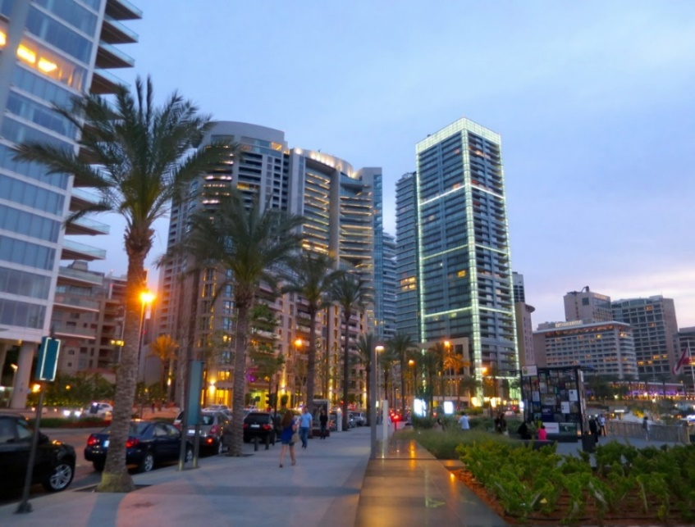
RESTRUCTURING THE PUBLIC ADMINISTRATION
- Portugal -
THE PRACE REFORM
Restructuring program of the central state administration
AUGUST/2005 – APRIL/2006
THE PREMAC REFORM
Central Administration Reduction and Improvement Plan
JULY/2011 – OCTOBER/2011
SHARED SERVICES

Slide 8
THE PRACE REFORM
Programa de Reestruturação da Administração Central do Estado
Restructuring program of the central state administration
AUGUST/2005 – APRIL/2006

Slide 9
THE PRACE INICIATIVE: AUG/2005 – APR/2006
Resolution of the Council of Ministers (RCM) 124/2005 created the Program of Restructuring of the Central State Administration (PRACE), a structural reform and transversal to all the Central Administration
GOALS:
To update and rationalize State Central Administration
To improve quality of services provided by the Administration to the Citizen
To bring Central Administration to a closer, dialogical stance with the Citizen
Constraints:
To be the fastest Programme (to recover one month of the initial delay);
To be the cheapest Programme (not to surpass the 180.000 Euro limit);
To be the most efficient Programme (efficiency measured in number of organic alterations produced);
To be the Programme that, indeed, essentially relies on the work of Administration own consultants (80 civil servants).

Slide 10
STRATEGIC GUIDELINES
To restructure/rationalize Direct and Indirect Administration taking Missions of Ministries, departments in their orbit, and Programme of the Government into account
To strengthen Strategic Functions, Study and Assessment/Control of Results of Governance Support
To strengthen Normative, Regulating and Inspection Functions of the State
To rationalize and eventually externalize Productive and Service Providing Functions.
To develop Common Service Pools, at ministry or inter-ministry levels, so as to reduce redundant structures and processes.
Horizontal and Vertical Communication must be made more flexible, less bureaucratic, and improved through the reduction of command chains and the creation of horizontal and matrix project structures, heavily resorting to Information and Communication Technologies.

Slide 11
STRATEGIC GUIDELINES (cont.)
The Functions of State Direct Administration at a regional level must be clarified and made uniform in accordance with the NUTS II model.
To reinforce Proximity to Citizens, be it through physical processes of deconcentration and decentralization, or through new channels of communication and services (Call-centres, Internet, local service outsourcing), developing one-stop-shopping logic by providing structural solutions that enable global, instantaneous response to Citizens (Automatic Multiservice Teller)
To improve the qualification of Processes, Work, and consequently of Central State Administration Agents.
To implement new Structures according to a strategy involving gradual steps and pilot testing.

Slide 12
HOW TO:
3 Phases/Steps:
a) Strategic framework;
b) Evaluation and organizational redefinition of structures and resources;
c) Execution phase.
Teams:
1 - At the political level - Orientation of the Prime Minister and direct orientation of 2 Ministers of State (Internal Affairs and Finance), in articulation with the other ministers.
2 - On a technical level - the Program is managed by:
Technical Commission - proposes methodologies to be carried out by each working group in each ministry, and presents a final report.
Evaluation working groups - under the guidance of the Technical Commission (mainly integrating AP agents with some support of private consultants); to carry out the analysis and evaluation of the attributions, competences, administrative structures, main administrative procedures and resources assigned to the ministry and to present a report to the Technical Comission with proposals for restructuring.

Slide 13
SPECIAL FOCUS OF THE TEAMS:
Progressive concentration of common activities, in particular within the General Secretariats (General Office), or in autonomous entities in areas such as:
a) budget management, financial, asset and cost accounting;
b) Recruitment and human resources management;
c) Information and communications technology (ICT);
d) Real estate management and fleet management;
e) Negotiation and acquisition of goods/services (procurement);
f) Treatment and preservation of documentation;
g) Legal support;
h) Security and cleaning services.

Slide 14
SPECIAL FOCUS OF THE TEAMS (cont.):
Objectives of sharing common activities:
The concentration of resources management and administration procedures, in each ministry, groups of ministries or sector;
The specialization of the entities and their personnel;
The orientation of the entities to its “core business”;
Reduction of structures and resources involved in support activities.
Promoting competition by promoting a "supplier/customer" approach.
Principles to be fulfilled by shared services entities:
Maintenance in the “customer” of management decisions;
Design of procedures for integration and optimization;
Contracting relations/services with “customer”;
Intensive use of ICT;
Implementation of cost accounting to evaluate the results.

Slide 15
STARTING POINT:
A different overview of public entities
PUBLIC
ENTITIES
POINT OF VIEW business/function
ACTIVITIES
FUNCTIONS/PROCESSES
PRODUCTS
GOODS AND SERVICES

Slide 16
STANDARD MINISTRY ORGANIZATION - MODEL
MINISTER
Support to policy formulation, strategic management, planning, financial programming and international relations
Financial Control Auditing
Misssion 1
Mission 2
Mission 3
Mission 4
Ministry’s Operational Activity
Information and Communication Techniques (ICT)
Budget, Accountancy and Treasury
Human Resources
Facilities, equipments, fleet management and acquisition of goods and services
Public Relations and Media
Documents and Archives
Support Activities = Common Service Pool

Slide 17
STANDARD MINISTRY ORGANIZATION - MODEL
OPERATIONAL MISSIONS AND SUPPORT FUNCTIONS
main concepts:
Operational Missions of each Ministry are those that translate into main policies and public action.
  (Organic structures corresponding to these functions do not follow a particular model: Organization depends on each department following mission specificity)
Support Functions, which translate into missions complementary to operational missions, on which, however, efficacy and efficiency depend.

Slide 18
STANDARD MINISTRY ORGANIZATION - MODEL
1 - Operational Missions:
1.1 - Normative, Regulating and Inspection Functions: overall tendency to reinforce by rationalization
1.2 - Productive and Service Providing Functions: key rational criteria are deconcentration, decentralization and (if required) externalization, in pace with the goal of making Administration closer to citizens and promoting physical/virtual channels.
2 - Support Functions:
2.1 - Governance Support Functions: activities revolving around Strategy, Planning and Management Control.
2.2 - Functions of Support to Resource Management: activities revolving around efficient management of complementary resources, nevertheless needed for the achievement of Operational Missions.

Slide 19
STANDARD MINISTRY ORGANIZATION - MODEL
2.1 - Governance Support Functions (RCM 39/2006):
2.1.1 - Service for Planning, Strategy, Assessment and International Relations– (Annex I, RCM 39/2006):
Technical support to policy formulation and strategic and operational planning (E.g.: benchmarking tools and analysis, international trends.)
Support to Ministry’s International Relations
Coordination of drafting of Action Plans and Financial Programming
Coordination/control of performance and result indicators, contingency plans, service ratings and management indicators
2.1.2 - Inspection and Auditing Service (Annex II 39/2006)
To appreciate lawfulness and regularity of service acts, as well as to assess their management and results, through technical, performance and financial auditing control.
Whenever necessary, frames external auditing.
2.1.3 - Financial Controller – Decree-Law 33/2006.

Slide 20
STANDARD MINISTRY ORGANIZATION - MODEL
2.2 - Functions of Support to Resource Management (RCM 39/2006):
2.2.1 - General Office (general secretariat):
Technical and administrative support to government members and Ministry services, in the areas of internal resources management, technical-juridical and legal support and attributions of art. 31st of L 4/2004.
2.2.2 - Common service pool:
  With RCM 39/2006 there is the onset of a strategy of creation of Common Service Pools – in the domains of financial, human, material and patrimonial management to be put to practice in the short term through a Mission Structure in the Ministries of Finance and Public Administration (see Annex III, RCM 39/2006).
  In each General Direction or Public Institute there should be one sole organic subunit with competence to manage resources
  In Ministries with specificities demanding it, there will be trial shared services in human resources directly relating to such specificities.

Slide 21
STANDARD MINISTRY ORGANIZATION - MODEL
2.2.2 - Common service pool (cont.):
Information and Communication Technologies:
  The Agency for Administrative Modernization, P I, (AMA/PCM), takes over the definition of strategic, transversal P.A policies, namely in matters of rules of interoperability and accessibility, taxonomy, safety rules and standardization of information.
  The Entity for Electronic State Certification – Infrastructure of Public Keys (ECEE in Portuguese), in articulation with the Government Information Network Management Centre vouches for the use of electronic signatures, strong authentication and the carrying out of secure transactions.
  As a rule, each Ministry should hold an Information and Communication Technology Service, aiming at defining ministry ITC policies and strategies, as well as ensure planning, conception, execution and assessment of informatization and technological updating of their services (attributions: Annex IV, RCM 39/2006)

Slide 22
STANDARD MINISTRY ORGANIZATION - MODEL
3 - Consulting bodies:
Concentration of bodies of a consulting nature or inter-ministerial coordination, privileging functioning by sections;
Placement of those bodies close to services and ministry departments with competence in matters of consulting or coordination;
Placement close to GPEARI (a Directorate General for Planning, Strategy, Assessment and International Relations) or, as a last resort, close to the Minister, when consulting or coordination functions relate to several of the Ministry’s attributions.

Slide 23
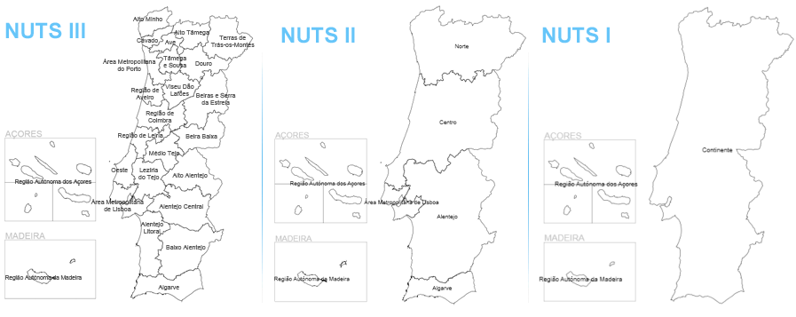
STANDARD MINISTRY ORGANIZATION - MODEL
4 - Deconcentrated services – regional, sub-regional and local :
Formatted according to territorial circumscriptions of NUTS II (DL 46/89 and DL 317/99);
To ensure balanced regional distribution – different urban centres (after consulting with Civil Governors);
Optimization of physical and human resources and minimization of impact of mobility on civil servants
Service sharing and creation of multiservice tellers at sub-regional and local levels.

Slide 24
STANDARD MINISTRY ORGANIZATION - MODEL
5 - Decentralization of services:
Preparing proposal of competences, functions and structures to be decentralized to local administration (June 2006)
In accordance with the principle of subsidiarity, the following will be identified:
  Typical regional planning, management and investment choices which, while there are no administrative regions (existing in the Constitution but never implemented except Madeira and Acores), should be exercised by regional deconcentrated services;
  Competences which, due to their nature or scale of intervention should be decentralized to the metropolitan areas of Lisbon or Porto or to associations of municipalities corresponding to NUTS III or the aggregation of NUTS III;
  Local management, investment, inspection and licensing competences, of an essentially executive or service providing nature, to decentralize to municipalities, or, in terms to be defined, to adequately sized local councils (freguesias).

Slide 25
STANDARD MINISTRY ORGANIZATION - MODEL
6 - Outsourcing/contracting out:
In cases where gains in efficiency or efficacy may exist, activities deemed not critical to State Functions may be considered to be transferred to the private or social sectors.
The transfer of functions may assume forms which range from state companies (state business sector) to total privatization, having in-between a “third sector” (non-profit organizations), or outsourcing (the State is in charge of the function but hires a third party to carry it out) and state-private partnerships.

Slide 26
ORGANIC STRUCTURE MODEL - TYPE 1
MINIST
MINIST
MINISTRY X
É
É
RIO X
RIO X
CONFIGURATION
CONCENTRATED AT CENTRAL LEVEL
MEMBROS DO GOVERNO
MEMBROS DO GOVERNO
Government members
Estrutura respons
Estrutura respons
á
á
vel pela fun
vel pela fun
ç
ç
ão de suporte
ão de suporte
A1
Structure encharged with Support function to:
Planning, strategic management, support to policy definition, financial planning and international relations
A1
A1
de: planeamento, gestão estrat
de: planeamento, gestão estrat
é
é
gica, apoio
gica, apoio
à
à
Controlo
Controlo
(Fun
Financial
Control
(Fun
(Support
ç
ç
ç
ão
ão
Auditoria
Auditoria
defini
Auditing
defini
ç
ç
ão de pol
ão de pol
í
í
ticas, planifica
ticas, planifica
ç
ç
ão financeira e
ão financeira e
Financeiro
de suporte)
Financeiro
de suporte)
Function)
rela
rela
ç
ç
ões internacionais
ões internacionais
A2
A2
A2
Estrutura ou estruturas respons
Estrutura ou estruturas respons
á
á
veis
veis
(Fun
Support
Structure or structures encharged with other support functions
(Fun
ç
ç
ões
ões
por outras fun
por outras fun
ç
ç
ão de suporte
de suporte)
ão de suporte
de suporte)
Functions
B
B
B
Estrutura
Estrutura
Structure
Estrutura
Estrutura
Structure
Estrutura
Estrutura
(Missões
Structure
(Missões
(Missions
para a
para a
for
para a
para a
for
para a
para a
e Fun
Mission
for
e Fun
And Operational
ç
ç
ões
ões
Estrutura
Estrutura
Estrutura
Estrutura
Estrutura
Estrutura
Mission
fun
Structure
fun
ç
ç
ão
ão
fun
fun
ç
ç
ão
ão
fun
fun
ç
ç
ç
ão
operational
operational
ão
Operacionais)
operational
Operacionais)
Functions)
para a
para a
Structure
para a
para a
para a
para a
operacional
for
operacional
function
operacional
operacional
function
operacional
Structure
operacional
Missão
function
Missão
Missão
Missão
Missão
Missão
A
Mission
A
A
A
A
A
B
B
A
B
A
A
B
B
B
D
D
das Missões
D
das Missões
of Missions
da Missão
da Missão
of Mission
da Missão
da Missão
of Mission
A, B e D
A, B e D
A, B e D
C
C
C
C
C
C

Slide 27
ORGANIC STRUCTURE MODEL - TYPE 2
MINIST
CONFIGURA
Ç
ÃO
MINIST
MINISTRY X
É
É
RIO X
RIO X
DECONCENTRATED CONFIGURATION FOR CERTAIN MISSIONS AND CONCENTRATED FOR OTHERS
DESCONCENTRADA PARA
CERTAS MISSÕES E
MEMBROS DO GOVERNO
CONCENTRADAS PARA
MEMBROS DO GOVERNO
GOVERNMENT MEMBERS
OUTRAS
Estrutura respons
Estrutura respons
á
á
vel pela fun
vel pela fun
ç
ç
ão de suporte de
ão de suporte de
A1
Structure encharged with Support function to:
Planning, strategic management, support to policy definition, financial planning and international relations
A1
A1
planeamento, gestão estrat
planeamento, gestão estrat
é
é
gica, apoio
gica, apoio
à
à
Controlo
Controlo
(Fun
Financial
Control
(Fun
(Support
ç
ç
ão
ão
Auditoria
defini
Auditing
Auditoria
defini
ç
ç
ão de pol
ão de pol
í
í
ticas, planifica
ticas, planifica
ç
ç
ão financeira e
ão financeira e
Financeiro
de suporte)
Financeiro
de suporte)
Function)
rela
rela
ç
ç
ões internacionais
ões internacionais
A2
A2
A2
Structure or structures encharged with other support functions
Estrutura ou estruturas respons
Estrutura ou estruturas respons
á
á
veis
(Fun
veis
(Fun
(Support
ç
ç
ões
ões
por outras fun
por outras fun
ç
ç
ão de suporte
de suporte)
ão de suporte
de suporte)
Functions)
B
B
B
Estrutura
Estrutura
Structure
Estrutura
Estrutura
(Missões
Strucure
(Missões
(Missions and
Estrutura
Estrutura
Coordination
para a
para a
For
para a
para a
e Fun
For
e Fun
ç
ç
ões
ões
Estrutura
Estrutura
Mission
Estrutura
Estrutura
Mission
de
de
fun
fun
operational
ç
ç
ão
ão
fun
fun
operational
ç
ç
ão
Operacionais)
ão
Operacionais)
Operational functions
para a
para a
para a
para a
coordena
coordena
ç
ç
ão
Structure
ão
operacional
operacional
function
operacional
operacional
Missão
function
Missão
Structure
Missão
Missão
Structure
para a
para a
for
A
A
A
B
B
A
B
A
A
B
B
B
Missão
Missão
Mission
da Missão
da Missão
for Mission
da Missão
da Missão
C
for Mission
C
C
D
D
D
D
D
D
N
N
C
N
C
C
U
U
U
Estrutura
Estrutura
Regional
Estrutura
Estrutura
Regional
Estrutura
Estrutura
Regional
Estrutura
Estrutura
Regional
Estrutura
Estrutura
(Missões
Regional
(Missões
(Missions
T
T
T
Regional 1
Regional 1
Structure 1
Regional 2
Regional 2
Structure2
Regional 3
Regional 3
Structure 3
Regional 4
Regional 4
Strucutre 4
Regional 5
Regional 5
e Fun
Structure 5
e Fun
And Deconcentrated
ç
ç
ões
ões
S
S
S
para as
para as
for
para as
para as
para as
para as
for
para as
para as
for
para as
para as
Desconcentradas)
for
for
Desconcentradas)
Functions
II
II
II
Missão
Missão
Mission
Missão
Missão
Mission
Missão
Missão
Mission
Missão
Missão
Mission
Missão
Missão
C
Mission
C
C
C
C
C
C
C
C
C
C
C
C
C
C

Slide 28
ORGANIC STRUCTURE MODEL - TYPE 3
MINIST
MINIST
MINISTRY X
É
É
RIO X
RIO X
CONFIGURA
Ç
ÃO
DECONCENTRATED CONFIGURATION FOR ALL MISSIONS
DESCONCENTRADA PARA
MEMBROS DO GOVERNO
TODAS AS MISSÕES
MEMBROS DO GOVERNO
GOVERNMENT MEMBERS
Structure encharged with Support function to:
Planning, strategic management, support to policy definition, financial planning and international relations
Estrutura respons
Estrutura respons
á
á
vel pela fun
vel pela fun
ç
ç
ão de suporte de
A1
ão de suporte de
A1
A1
planeamento, gestão estrat
Financial
Control
planeamento, gestão estrat
é
é
gica, apoio
gica, apoio
à
à
Controlo
(Fun
Controlo
Auditing
(Fun
(Support
ç
ç
ão
ão
Auditoria
defini
Auditoria
defini
ç
ç
ão de pol
ão de pol
í
í
ticas, planifica
ticas, planifica
ç
ç
ão financeira e
ão financeira e
Financeiro
de suporte)
Financeiro
de suporte)
Function)
rela
rela
ç
ç
ões internacionais
ões internacionais
A2
A2
A2
Structure or structures encharged with other support functions
Estrutura ou estruturas respons
Estrutura ou estruturas respons
á
á
veis
(Fun
veis
(Fun
(Support
ç
ç
ões
ões
por outras fun
por outras fun
ç
ç
ão de suporte
de suporte)
ão de suporte
de suporte)
Functions)
B
B
B
(Missões
(Missões
(Missions
Estrutura
Estrutura
e Fun
Coordination
e Fun
ç
ç
ões
ões
and operational
de
Operacionais)
de
Operacionais)
Functions)
coordena
coordena
Structure
ç
ç
ão
para as
ão
para as
for
Missões
Missões
Missions
A e C
A e C
A and C
N
N
C
N
C
C
U
U
U
Estrutura
Estrutura
Regional
Estrutura
Estrutura
Regional
Estrutura
Estrutura
Regional
Estrutura
Estrutura
Regional
Estrutura
Estrutura
(Missões
Regional
(Missões
(Deconcentrated
T
T
T
Regional 1
Regional 1
Structure1
Regional 2
Regional 2
Structure 2
Regional 3
Regional 3
Structure 3
Regional 4
Regional 4
Structure 4
Regional 5
Regional 5
e Fun
Structure 5
e Fun
Missions and
ç
ç
ões
ões
S
S
S
para as
para as
for
para as
para as
for
para as
para as
for
para as
para as
for
para as
para as
Desconcentradas)
for
Desconcentradas)
Functions)
II
II
II
Missões
Missões
Missions
Missões
Missões
Missions
Missões
Missões
Missions
Missões
Missões
Missions
Missões
Missões
A, B, C e D
Missions
A, B, C e D
A, B, C and D
A, B, C e D
A, B, C e D
A, B, C and D
A, B, C e D
A, B, C e D
A, B, C andD
A, B, C e D
A, B, C e D
A, B, C and D
A, B, C e D
A, B, C e D
A, B, C and D

Slide 29
PRACE TIMETABLE:
PRACE - SCHEDULE / ACTIONS
 |  | AGOSTO |  |  |  |  | SETEMBRO
 |  | 1 | 2 | 3 | 4 | 5 | 6 | 7 | 8 | 9
STRATEGIC FRAMEWORK PHASE
1 | Publication of RCM no. 124/2005
2 | Appointment of the Technical Committee (TC)
3 | CT meeting with MAI and MF
4 | Presentations of previous works
5 | Preparation of ministerial meetings
6 | Ministerial meetings
7 | Consultants selection
8 | Establishment of Working Groups
EVALUATION AND RESEARCH PHASE
9 | Definition of the methodology to be applied
10 | Formation
11 | Survey of information
12 | Assessment of the current situation
13 | Preliminary drawing of the new macro-structure of the Ministry and attributions of each entity
14 | Preliminary drawing of each structure (Directorate-General) and preliminary definition of competences
15 | Definitive design of the Ministry's macro-structure to be submitted by the CT to the Government (Report)
 | Presentation to the Government of the macro-structure
16 | Definitive drawing of each structure (Directorate-General) and definitive definition of competences (Summary report)
17 | Presentation to the Government by the TC of the synthesis report on each structure (Direct.-General)

Slide 30
PRACE TIMETABLE (cont.):
IMPLEMENTATION PHASE / ACTIONS |  | SEMANAS
 |  | Junho |  |  |  | Julho
 |  | 1 | 2 | 3 | 4 | 5 | 6 | 7 | 8
1 | Presentation of the report of the PRACE Technical Commission on micro-structures
2 | Meeting to present the Monitoring Teams, who prepare and coordinate the making of the organic laws of the Ministry / Entities to their interlocutors in the Ministry and presentation of the methodology of work
3 | Elaboration of the proposals of Organic Laws (LO) of each Ministry
4 | Confirmation of LO proposal by Sector Minister
5 | Submission to SEAP of the LO proposals of the Ministry
6 | Assessment of LO by the Monitoring Teams and final version of LO
7 | Approval and publication of LOs from each Ministry
8 | Confirmation by the Government of the micro-structures and their respective attributions and competences proposed in the CT / WG reports
9 | Presentation by the Ministry (to the Monitoring Teams) of the timetable to elaboration of LO
10 | Elaboration and presentation of LO of each agency of the Ministry
 | All entities that have been created / merged; and
 | All entities that total 75% (expense) of the Ministry Budget
11 | Submission to the SEAP of the proposals of LO of each organism
12 | Assessment of LO by the Monitoring Teams and final version of LO
13 | Approval and publication of LO of each organism
14 | Progress meetings, weekly / biweekly, between Follow-up Team and interlocutors in the Ministry

Slide 31
PRACE: GLOBAL QUANTITATIVE RESULTS (summary)
TYPE | STRUCTURES
 | Start Situation | Closed [6] | Maintain | New | Final Situation | VAR
Consulting bodies [1] | 78 | 38 | 39 | 5 | 44 | -34
Central Services [2] | 254 | 98 | 156 | 37 | 193 | -61
Deconcentrated services [3] | 157 | 101 | 56 | 14 | 70 | -87
Mission Structures [4] | 7 | 1 | 6 | 4 | 10 | 3
Others [5] | 22 | 8 | 14 | 0 | 14 | -8
Total | 518 | 246 | 271 | 60 | 331 | -187
- Less Departments/Divisions: - 1.307 - 24,9%
- Less top/middle Managers: - 1.468 - 24,7%
- New bodies of Shared Services: National Agency for Public Procurement and GeRAP, EPE
- Before - 30 different models of territorial organization
- After - 2 models:
i. NUTs II (5): planning and social, economical and environmental coordination
ii. Districts (18): security issues, civil protection, taxes and social security
[1] Includes Councils, Commissions and similar structures.
[2] Includes Direct and Indirect State Administration Services.
[3] Includes De-concentrated services in the direct dependence of Government members.
[4] Includes Mission Structures and equivalents (“temporary”) .
[5] Includes Higher Education, Academies, Foundations and structures not included in the previous points.
[6] Includes structures to be outsourced and decentralized.

Slide 32
PRACE: MOST IMPORTANT RESULTS
State structure more coherent;
Rational ordering of assignments and competences (without positive and negative conflicts);
Reduction of Macro-Structures;
Reduction of Indirect Administration;
Reduction of Senior Management Positions (1st & 2nddegree);
Reduction of Intermediate Management Positions;
Standardization of the Deconcentrated Administration;
Reinforcement of Governance functions: Inspections; GPEARI; Financial Controllers; General Secretariats;
Beginning of institutionalized Shared Services.

Slide 33
PRACE: MOST IMPORTANT RISKS
GLOBAL RISK:
Simultaneous change processes
Mobility of workers between services: Expectations created
RISKS IN EMPLOYMENT CONTRACTS, CAREERS AND WAGES:
Very complex legislative procedure:
- Legal Regime of the Contract of Work in Public Functions;
- Leaders Statutes;
- Revision of the Law of Mobility;
- Revision of the Disciplinary Statute;
- Approval of Special Careers;
- Review and approval of Salary Supplements.
RISK AS TO SIADAP (PERFORMANCE ASSESSMENT SYSTEM):
- Service/agencies Evaluation Process
- Leaders Evaluation Process
- Employee Evaluation Process

Slide 34
PRACE: MOST IMPORTANT RISKS (cont.)
POLITICAL CONSENSUS:
    At that time, the discussion on Portugal was more about quantity (who will cut more) then about the need of the reform.
    Only a few were against reducing the weight of the Public Sector:
      Everyone agreed that:
      The same work was done in different ministries and even in the same ministry (duplication) and some functions were not done in any ministry (no one does)
      Delivery to citizens and companies (in their daily interactions with public administrations) was fragmented: no single entry point
      Lack of coordination and programs implementation between departments of each ministries
POLITICAL LEADERSHIP:
- The Technical Comm. was close to PM but, at the same time, with great technical independence, which helped to overcome some difficulties ("in my ministry I’m the one in charge").

Slide 35
PRACE: MOST IMPORTANT RISKS (cont.)
RESISTANCES/CHANGE MANAGEMENT/INCENTIVES
- Resistances: Every one agree (in public) that something should be done to reform the Public Sector.
Resistance was particularly evident when we talk of Deconcentrated services or when we talk of Decentralization.
Some novelty may not work: the Financial Controller (created in each ministry reporting to the respective minister and also to the Minister of Finance). The nominees were seen by each minister as "spies" of the finance minister (does not exist anymore).
Change management: - is usually forgotten or does not exist.
After the report of the Tech. Commission was approved by the Government, its execution was translated into organic laws of each ministry and they were implemented, by virtue/force of the law.
Once the technical process is completed, the monitoring and evaluation dimension is (almost always) forgotten.
- Incentives: The incentives for change are also quickly forgotten (the same as for communication management). In theory, the savings generated by the mergers and extinctions of organisms, can revert in favor of the new entities. However, this rarely happens.

Slide 36
THE PREMAC REFORM
Plano de Redução e Melhoria da Administração Central
Central Administration Reduction and Improvement Plan
JULY-OCTOBER/2011

Slide 37
THE PREMAC EXPERIENCE: JUL-OCT/2011
The Council of Ministers approved (20/JUL/2011), the outlines of PREMAC.
MAIN GOAL:
Comply with the Portugal: memorandum of understanding on specific economic policy conditionality (May 3, 2011)
The Memorandum of Economic and Financial Policies (MEFP) and the Memorandum of Understanding (MoU), specifies the criteria that will be assessed for the successive reviews up to the end of the programme of assistance signed with EU, IMF and ECB:
MoU: “3.38. Reduce management positions and administrative units by at least 15% in the central administration. [Q4-2011]
3.39. In view of improving the efficiency of the central administration and rationalising the use of resources, implement a second phase of the public administration restructuring programme (PRACE 2007). [Q4-2011]”
MEFP: “23. The structure of PA will be streamlined. A second phase of PRACE 2007 will be implemented for central government by end-2011 (…) The objective will be to improve efficiency, and reduce the size of PA across all levels. We will reduce the number of central government employees by at least 1% a year over the duration of the program, with at least 2% reduction at the local level, through a policy of only partly replacing separating staff, while at the same time increasing mobility across the administration. As part of these reforms, we will reduce management positions and administrative units by at least 15% (on average, over end-2010 levels) by end-2011 for central government and end-June 2012 for local governments.

Slide 38
WORKING METHODOLOGY AND TIMETABLE ADOPTED PREMAC
The overall political conduct of the Plan was under the joint responsibility of the Prime Minister and the Minister of State and Finance, and the Deputy Secretary of State of the Prime Minister and the Secretary of State for Public Administration were entrusted with the task of coordinating, in political and operational terms, the process. For each ministry, a political interlocutor (Secretary of State) was appointed and a technical leader for the development of the work.
On the technical level, the implementation of the Plan was carried out by a team designated by the Secretary of State for Public Administration, with the follow-up of ESAME members (Monitoring Committee for Memorandums).

Slide 39
PREMAC TIMETABLE:
Date 2011 | Event
July 20 | Approval by the Council of Ministers of the proposal for the implementation of PREMAC
July 26 | Appointment and communication of the political and technical partners of each Ministry for the implementation of PREMAC
Until Aug. 3 | Making available the formats of organic laws
3-31 Aug. | Negotiations at the political level, with a view to meeting the reduction percentages of structures and officials defined by the Government, in line with the preparation by the sectoral ministries of the respective reorganization plans: -1st Phase: 1st meeting between SEAP / SEAPCM and sectoral partners to define the guidelines transversal to the reorganization plans -2nd Phase: 2nd meeting between SEAP/SEAPCM and sectoral partners to verify and final agreement on the percentages of reduction (structures/ leaders)
Sept. 5 | Approval of the PREMAC Report by the Council of Ministers
After Sept. 22 | Elaboration of the proposals of organic laws and their regulation Meetings of the technical interlocutors of each Ministry with SEAP, for analysis and verification of all organic laws and respective regulations (organic certificates of services and bodies, as well as ordinances of internal structures)
October 26 | Approval by the Council of Ministers of the organic laws of the Ministries

Slide 40
PREMAC RESULTS:
TYPE | STRUCTURES
 | Start Situation | Closed | Maintain | New | Final Situation | Var N.º | Var %
Direct Administration | 145 | 66 | 79 | 19 | 98 | -47 | -32%
Indirect Administration | 74 | 21 | 53 | 4 | 57 | -17 | -23%
Consulting bodies | 122 | 67 | 55 | 2 | 57 | -65 | -53%
Others | 18 | 14 | 4 | 1 | 5 | -13 | -72%
Total | 359 | 168 | 191 | 26 | 217 | -142 | -40%
MANAGERS
Start Situation |  | Final Situation |  | VAR
Top Managers | Middle Managers | Top Managers | Middle Managers | Top Managers | Middle Managers
715 | 5 571 | 440 | 4 135 | -275 | -1 436
6 286 |  | 4 575 |  | -1 711
 |  |  |  | -38% | -26%
 |  |  |  | -27%

Slide 41
SHARED SERVICES INICIATIVE
Starts at February/2007

Slide 42
PRACE - SHARED SERVICES INITIATIVE:
Starting Point
Process
Technology
Organization & People
Development of a culture centered on the client
Process reengineering with value creation
Supplier/Partner
Business unit
Value
Service provider
Customer Loyalty
Based on customer needs
Alignment of processes with the business
Standardized processes, best practices
Technological strategy aligned with the business
Basic characteristics of the technological solution
Integrated system
Reduced data maintenance
Data integration
Validation of data at source
Relevant and timely information
Built-in features
Integration and interfaces
Configuration
Scalability

Slide 43


(Government Shared Services Agency)
Shared Services for
a Smart Government

Slide 44
FINAL REMARKS: Critical Success Factors
Sponsorship of top management and government support
Clearly definition of management structure, roles and responsibilities
Definition of service level agreements with clients
Definition of a strong business case
Definition and implementation of a effective communication and change management plan
Effective management of project risks
Availability of qualified resources (project management, functional and technical skills)
Robust and flexible technological platform
A phased approach to implementation
Follow best practices

Slide 45
Last but not least, always remember:
In most cases administrative reforms are not implemented by those who design it, and that’s true also for the new structures: the ones that promote the new structure don’t have to manage with it.

